Slide 1

Investor Presentation
July 2015
OTCQX: RESX

Slide 2
This presentation includes "forward-looking statements" under the Private Securities Litigation Reform Act of 1995. All statements other than statements of historical facts contained in this presentation, including statements regarding our anticipated future clinical and regulatory events, future financial/position, business strategy and plans and objectives of management for future operations, are forward-looking statements. Forward-looking statements can be identified by words such as “potential,” "may," "will," "should," "forecast,“ "project," "could," "expect," "believe," "estimate," "anticipate," "intend," "plan,“ “continue”, other words of similar meaning, derivations of such words and the use of future dates. Forward-looking statements in this presentation include, without limitation, statements regarding our current business strategies, the potential future commercialization of our product candidates, potential estimated market sizes for our product candidates, anticipated start dates, durations and completion dates, as well as potential future results, of our future clinical trials, anticipated designs of our future clinical trials, and anticipated future regulatory submissions and events. Uncertainties and risks may cause actual results to be materially different than those expressed in or implied by our forward-looking statements. Particular uncertainties and risks include, among others, uncertainties regarding our ability to license out our existing and license in additional products and technologies and the terms of such licenses; uncertainties involved in clinical testing, the difficulty of developing pharmaceutical products, obtaining regulatory and other approvals and achieving market acceptance, and other risks and uncertainties described in our filings with the Securities and Exchange Commission, including our most recent annual report on Form 10-K/A, subsequent quarterly reports on Form 10-Q and final prospectus dated July 31, 2014. All forward-looking statements in this presentation speak only as of the date of this presentation and we undertake no obligation to update or revise any forward-looking statement, whether as a result of new information, future events or otherwise.

Slide 3
Company Highlights
Specialty biopharmaceutical company focused on developing products for ophthalmology, oncology and dermatology
Two core proprietary technologies applicable in multiple indications
  RES-529: PI3K/Akt/mTOR Pathway Inhibitor (AMD, Glioblastoma)
  RES-440: “Soft” Anti-Androgen (Acne)
  Strong preclinical in-vitro and in-vivo data
Two Phase I clinical trials completed for RES-529 in AMD
Three Phase I/II clinical trials to be initiated in mid-2016
  Age Related Macular Degeneration (AMD)
  Glioblastoma (Orphan Drug designation received)
  Acne
Solid balance sheet with no debt
Experienced management team supported by strong board of directors

Slide 4
Experienced Management Team
Stephen M. Simes - Chief Executive Officer
  BioSante, Unimed, Bio-Technology General, Gynex, Searle
Phillip B. Donenberg, CPA – Chief Financial Officer
    BioSante, Unimed, Gynex
Mark Weinberg, MD, MBA – Senior VP, Clinical Development
  Astellas, Lundbeck, Ovation, Takeda, Abbott

Slide 5
Strong Board of Directors
Sol Barer, PhD - Chairman
  Former CEO & Executive Chairman, and Chairman, Celgene Corporation
  Board member Teva Pharmaceuticals, Aegerion Pharmaceuticals, Amicus Therapeutics
  Chairman of Medgenics, InspireMD and Contrafect Corporation
Isaac Blech - Vice-Chairman
  Leading biotechnology entrepreneur and investor
  Genetic Systems, Nova, Celgene, ICOS, Texas BioTechnology, Pathogenesis
Stephen M. Simes – CEO
  BioSante, Unimed, Bio-Technology General, Gynex, Searle
Rex Bright
  SkinMedica, J&J, GlaxoSmithKline, Allergan
Nelson Stacks
  Waveguide Corporation

Slide 6
Summary Product Portfolio & Timelines
Program / Therapeutic Area |  | 2014 | 2015 | 2016
RES-529 | OPHTHALMOLOGY Age-Related Macular Degeneration (AMD)
 | ONCOLOGY Glioblastoma Multiforme (GBM)
RES-440 | DERMATOLOGY Acne
Phase I IVR
Formulation / Nonclinical
Phase I/II
SubConj
Phase I
SubConj (NEI)
Formulation / Nonclinical
Phase I/II
Formulation / Nonclinical
Phase I/II

Slide 7
RES-529
    First-in-class PI3K/Akt/mTOR pathway inhibitor

Slide 8
RES-529 & the PI3K Pathway
The PI3K/Akt/mTOR pathway is an important signaling pathway for many cellular regulation functions such as cell proliferation, angiogenesis and vascular permeability
  Significant therapeutic opportunities for pathway signaling
  Agents in development affect different targets
    PI3K inhibitors
    Akt inhibitors
    mTOR inhibitors
RES-529 is a novel approach to inhibition of the PI3K pathway
  Rather than interfering with the pathway directly via specific signaling proteins (e.g. PI3K, Akt, mTOR), RES-529’s action results in the loss of the TORC1 and TORC2 protein complexes thus preventing these complexes from generating and potentiating signaling within the pathway.
    RES-529 is a first-in-class PI3K/Akt/mTOR pathway inhibitor

Slide 9
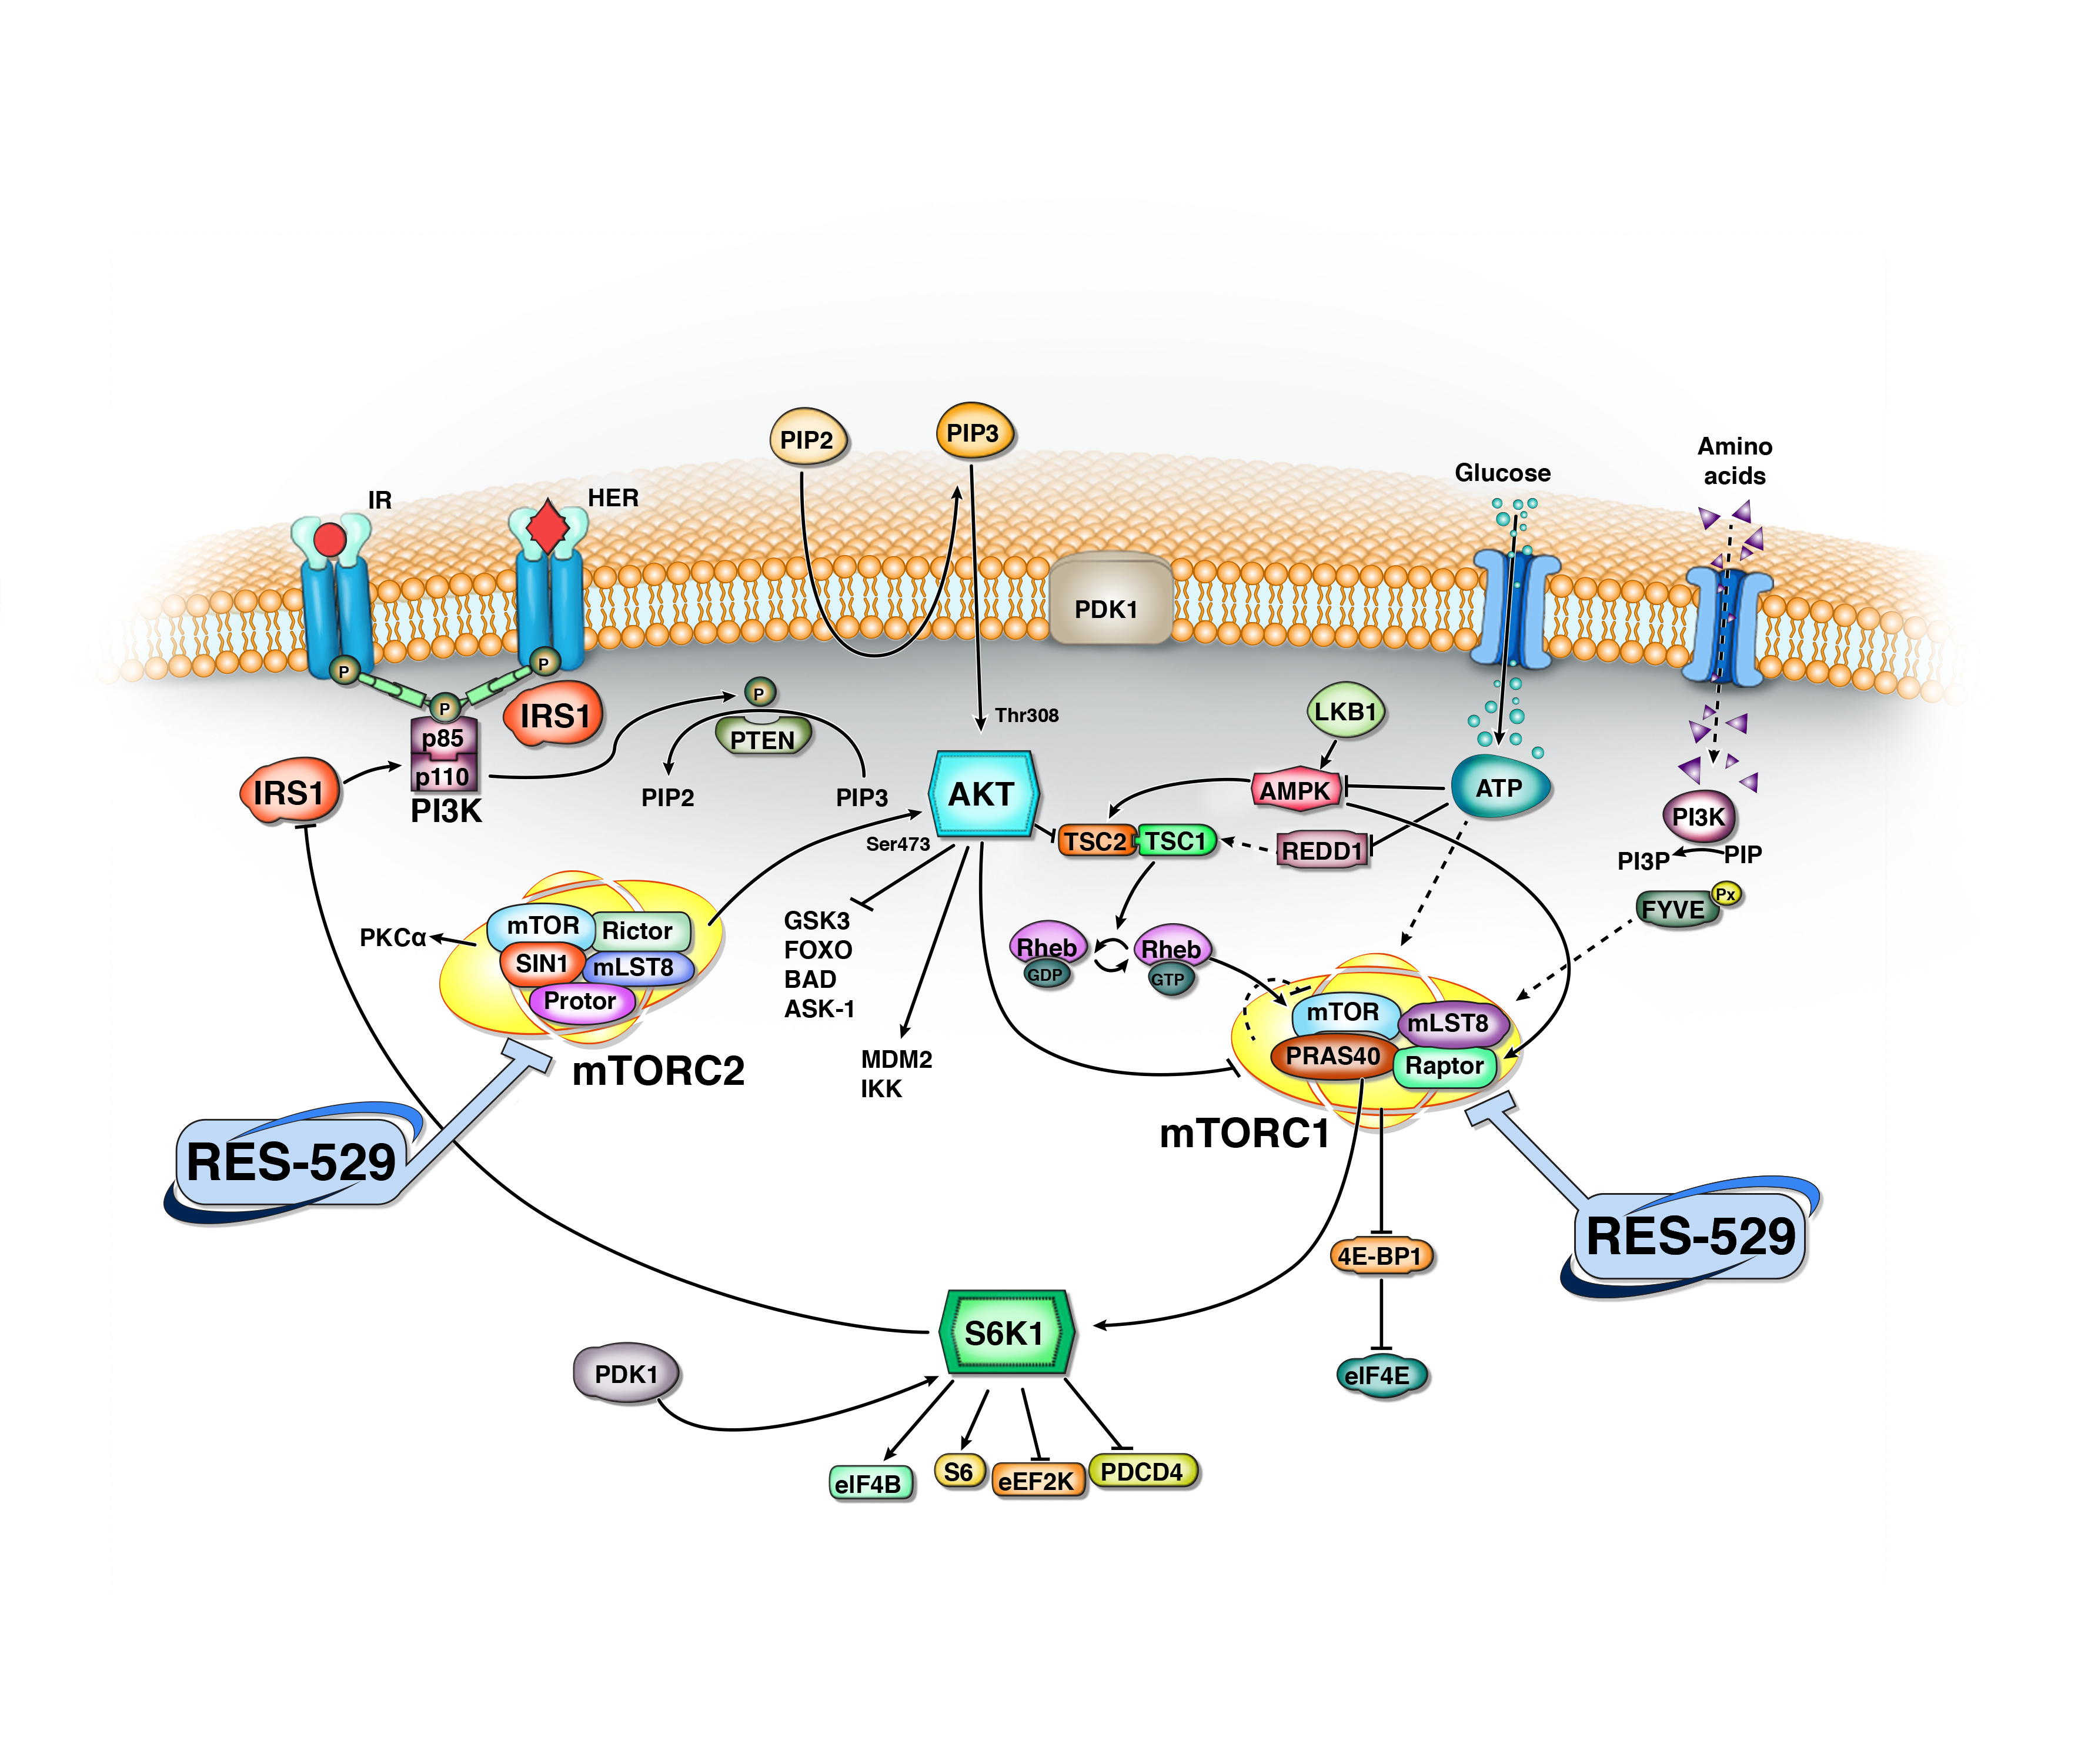
RES-529 Mechanism of Action
RES-529 interferes with the molecular components that form TORC1 and TORC2 preventing these complexes from generating and potentiating signaling and thereby interferes with the activities of the PI3K/Akt/mTOR pathway: translation, cell growth, ribosome biogenesis, metabolism, proliferation, and authophagy

Slide 10
Ophthalmology
RES-529
    First-in-class PI3K/Akt/mTOR pathway inhibitor

Slide 11
Ophthalmology Market
RES-529 initial ophthalmologic indication is for Wet AMD
Back of the eye diseases have large market size and financial potential
Wet AMD has approximately $6 billion in WW sales
20 million cases of Wet AMD in the US/EU
Age-Related Macular Degeneration
10% of patients 66 to 74 years of age will have findings of macular degeneration
Prevalence increases to 30% in patients 75 to 85 years of age
Competitor
Cost
Treatment
Sales
Lucentis (Genentech/Novartis)
Cost of single injection approximately $2,000.00
Treatments every four to six weeks
Approximately $4 billion for all indications
Eylea (Regeneron/Bayer/Sanofi)
Cost of single injection approximately
$2,000.00
Treatments every eight to twelve weeks
Approximately $2.8 billion for all indications

Slide 12
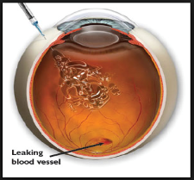
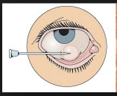
RES-529 Clinical Advantage in Wet AMD
RES-529 is being developed as a subconjunctival injection
Clinical trials for RES-529 will be designed to demonstrate that patients may transition from initial therapy (Lucentis, Avastin, Eylea) to RES-529
  Enabling patients to be maintained with subconjunctival (vs. intravitreal) administration
  Once every three months therapy compared with monthly or on demand therapy requiring frequent follow up
Intravitreal – needle penetrates into the globe of the eye
Subconjunctival – fluid is injected beneath the conjunctiva

Slide 13
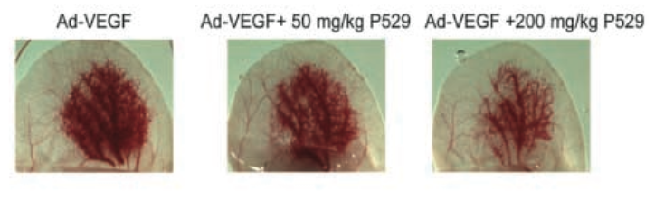
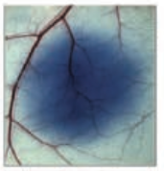
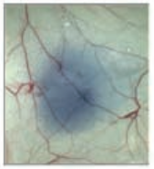
RES-529 Inhibits VEGF Induced Angiogenesis and Permeability
VEGF Induced Angiogenesis
Mice pretreated with RES-529 IP 24 hrs prior to intradermal injection of adenovirus expressing mouse VEGF-A164 to mouse ear
VEGF Induced Permeability
Mice pretreated with RES-529 IP 24 hrs prior to intradermal injection of 100 ng VEGF to ear; 0.1 ml of 0.5% Evans Blue given IV 30 minutes after VEGF treatment
VEGF
VEGF + RES-529
Xue Q. et al. Palomid 529, a Novel Small-Molecule Drug, Is a TORC1/TORC2 Inhibitor That Reduces Tumor Growth, Tumor Angiogenesis, and Vascular Permeability. Cancer Res 2008;68(22):9551–7.
RES-529 = P529 = Palomid 529

Slide 14
RES-529: Completed Phase I Trials in AMD
Protocol P52901 Company sponsored and conducted by Dr. Jeffrey Heier (Ophthalmic Consultants of Boston) and Dr. David Brown (Retinal Consultants Houston)
  A Phase I Open-Label Study to Investigate the Safety, Tolerability and Pharmacokinetic Profile of Single Intravitreal and Subconjunctival Doses of RES-529 in Patients with Advanced Neovascular Age-Related Macular Degeneration (AMD)
    15 patients treated via intravitreal injection
    Doses between 0.004mg and 0.5mg
Protocol 11-EI-0066 sponsored by National Eye Institute (NEI) and conducted by Dr. Catherine Meyerle
  A Phase I Unmasked Study to Investigate the Safety and Tolerability of Subconjunctival Injections of RES-529 in Patients with Neovascular Age-Related Macular Degeneration*
    5 patients treated with subconjunctival injections of 2mg qmo x 3
*Dalal M. et al. Subconjunctival Palomid 529 in the treatment of neovascular age-related macular degeneration. Graefes Arch Clin Exp Ophthalmol (2013) 251:2705–2709.
RES-529 = P529 = Palomid 529

Slide 15
RES-529: Clinical Data in AMD
Patients Enrolled:
  End stage patients who were refractory or not appropriate for VEGF therapy
  Most had significant visual deficits and retinal fluid on OCT
Safety/Tolerability:
  Intravitreal administration (Company sponsored study)
    Temporary haze attributed to drug particles at highest dose studied (0.5 mg )
      This effect resolved.
  Subconjunctival administration (NEI study)
    2mg monthly x 3 administered; generally well tolerated
    Depot formed at injection site
Efficacy:
  Preliminary evidence of biologic activity based on:
    Fluid pocket reduction
    Retinal thinning
    Cyst reduction

Slide 16
RES-529: Upcoming Studies in AMD
2015
Finalize CMC work for subconjunctival administration
2016
Complete pre-clinical studies necessary to allow for next clinical studies to be initiated in 2016
Phase I/II clinical trial in AMD
Determine MTD for subconjunctival administration
Safety and tolerability, as well as clinical efficacy

Slide 17
Oncology
RES-529
    First-in-class PI3K/Akt/mTOR pathway inhibitor

Slide 18
RES-529 in Glioblastoma
A True Unmet Medical Need – Glioblastoma
  Current Standards of Care:
    Temodar, Avastin, Gliadel Wafer
    Median survival with only supportive care, less than 6 months**
    Median survival with aggressive chemotherapy in combination with radiotherapy, 12 to 15 months**
RES-529 potential advantages:
  Activity shown in multiple in vitro and in vivo animal models for GBM
  Penetrates the blood brain barrier
  PI3K/Akt/mTOR pathway significantly up-regulated in glioblastoma
    First-in-class mechanism of action exerting PI3K/Akt/mTOR pathway control above other drugs targeting this pathway
    Specifically targets TORC1/TORC2 implicated in GBM
  Orally available: allows for improved administration and reduction in health care costs
  FDA Orphan Drug Designation granted January 2015
Market size expected to grow dramatically:
  2013 World Wide market ~ $1 billion
  2020 Expected WW market ~ $4.5 billion (Growth Rate of ~28%.* Growth will be driven primarily by new agents.)
** Treatment options and outcomes for glioblastoma in the elderly patient, N.D. Arvold and D. A. Reardon, lin Interv Aging. 2014; 9: 357–367
EvaluatePharma, Adis R&D Insight

Slide 19
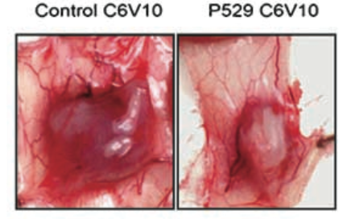
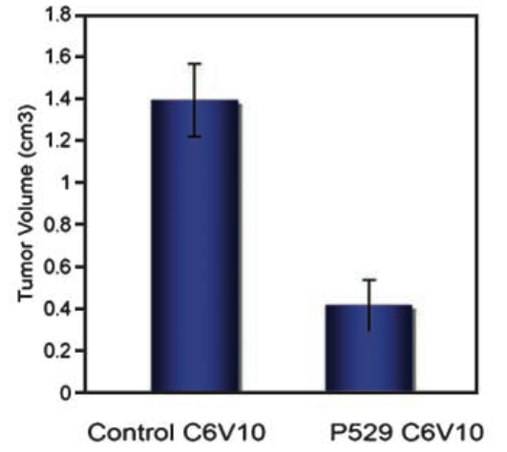
RES-529 Inhibits C6V10 Glioma Tumor Growth
  C6V10 model (fast growing tumor, constitutive VEGF secreting tumor)*
    Tumor growth inhibited in subcutaneous xenograft models
    Mice pretreated with RES-529 at 200 mg/kg/2 day, intraperitoneal for one week
    At second week, rat glioma cells were injected subcutaneous
    Treatment continued while tumors were allowed to grow for 21 days
    At termination, tumor volume reduced by 70% percent
Control C6V10
RES-529 C6V10
Control C6V10
RES-529 C6V10
*Data from Xue Q. et al Cancer Res 2008;68(22):9551–7. RES-529 = P529 = Palomid 529

Slide 20
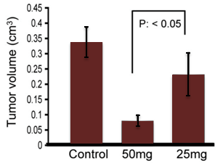



RES-529 Inhibits U87 Glioma Tumor Growth
Tumor growth inhibited in subcutaneous xenograft models
  U87 model (slow growing tumor)*
    Mice were injected subcutaneous with U87 glioma cells
    At day 3, mice began treatment with RES-529 at doses of 25 and 50 mg/kg/2 day intraperitoneal
    U87 tumors were allowed to grow for 24 days
    At termination, tumor volume reduced by 29% (25mg) and 76% (50 mg)
Control 25mg 50mg
*Data from Xue Q. et al Cancer Res 2008;68(22):9551–7. RES-529 = P529 = Palomid 529

Slide 21
RES-529: Extensively Studied in Preclinical Oncology Models
Efficacy in glioma subcutaneous xenograft model
  Similar efficacy regardless of route of administration (iv, po, or ip)¹
  Penetration of the blood brain barrier with pharmacologically active levels reached in murine brain2
Efficacy in multiple tumor types
  In NCI60 cell line panel³
    Breast cancer: efficacy in orthotopic xenografts⁴
    Prostate cancer: synergy with radiotherapy and chemotherapy in xenografts^{5,6}
    Lung cancer: efficacy in appropriate model
¹Xue Q. et al. Palomid 529, a Novel Small-Molecule Drug, Is a TORC1/TORC2 Inhibitor That Reduces Tumor Growth, Tumor Angiogenesis, and Vascular Permeability. Cancer Res 2008;68(22):9551–7 and Xue Q. unpublished data.
²Lin F. et al. Dual mTORC1 and mTORC2 inhibitor Palomid 529 penetrates the Blood–Brain Barrier without restriction by ABCB1 and ABCG2. Int J Cancer 2013Sep1;133(5):1222-33.
³Diaz R. et al. The novel Akt inhibitor Palomid 529 (P529) enhances the effect of radiotherapy in prostate cancer. Br J Cancer 2009Mar24;100(6):932-40.
⁴Xiang T. et al. Targeting the Akt/mTOR pathway in Brca1-deficient cancers. Oncogene 20011May26;30(21):2443-50.
⁵Gravinia GL. et al. Torc1/Torc2 Inhibitor, Palomid 529, Enhances Radiation Response Modulating CRM1-Mediated Survivin Function and Delaying DNA Repair in Prostate Cancer Models. Prostate 2014JanJun74(8);852-68.
⁶Gravinia GL. et al. The TORC1/TORC2 inhibitor, Palomid 529, reduces tumor growth and sensitizes to docetaxel and cisplatin in aggressive and hormone-refractory prostate cancer cells. Endocrine Related Cancer (2011);18:385-400
RES-529 = P529 = Palomid 529

Slide 22
RES-529: Planned Studies in Glioblastoma/Oncology
2015
Finalize CMC work for oral administration
2016
Phase I/II clinical trial in glioblastoma
- Efficacy assessment in recurrent glioblastoma - Determine MTD in glioblastoma
Conduct pre-clinical studies necessary to allow for IND clinical studies to be initiated in 2016
Plan Phase 2a studies in other tumor types using MTD dose
- non-clinical data in breast, prostate, and lung

Slide 23
Summary of Clinical Timelines & Milestones
  2015:
    Finalize CMC work for early clinical trials with RES-529 and RES-440
    Conduct pre-clinical studies necessary to enable submission of INDs and/or conduct of next clinical studies
  2016:
    AMD:
      Phase I/II clinical trial in AMD
        Safety and tolerability, as well as clinical efficacy
        Determine MTD for subconjunctival administration
    Glioblastoma:
      Phase I/II clinical trial in glioblastoma
        Efficacy assessment in recurrent glioblastoma
        Determine MTD in glioblastoma
      Plan Phase IIa studies in other oncology indications using MTD dose
        Current non-clinical data supports breast, prostate, and lung cancers
    Acne:
      Phase I/II clinical trial
        Assess safety and tolerability as well as efficacy
Near-term goal: increased stockholder value through active implementation of development programs

Slide 24
RestorGenex Summary Financial Information as of March 31, 2015
Cash: $19,200,000
Debt: $0
Planned burn rate in 2015: ~ $1.0 million/month
Shares outstanding: 18,614,968
Options outstanding: 3,248,430
Warrants outstanding: 4,815,266
Fully diluted: 26,678,664
Insider ownership: 30%

Slide 25
Key Takeaways
Specialty biopharmaceutical company focused on developing products for ophthalmology, oncology and dermatology
  Pipeline based on proprietary platforms
Two Phase I clinical trials completed for RES-529 in AMD
Three Phase I/II clinical trials to be initiated in 2H 2016
  Age Related Macular Degeneration (AMD)
  Glioblastoma (Orphan Drug designation received)
  Acne
Solid balance sheet with no debt
Experienced management team supported by strong board of directors

Slide 27
Appendix

Slide 28
Oncology
RES-529
    First-in-class PI3K/Akt/mTOR pathway inhibitor

Slide 29
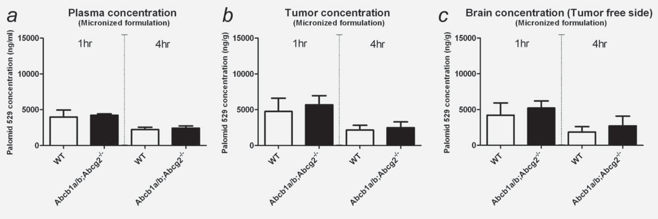
RES-529: Penetration of the Blood Brain Barrier
Both IV and oral administration of RES-529 demonstrated penetration of the blood brain barrier *
Plasma, brain, and tumor concentrations were evaluated in a U87 orthotopic xenograft model. Results demonstrated penetration of the blood brain barrier, similar concentrations in plasma, brain and tumor, no effect of the Abcb1 or Abcg2 transporters, and a statistically significant inhibition of tumor growth
*Data from Lin F. et al.. Int J Cancer 2013Sep1;133(5):1222-33. RES-529 = P529 = Palomid 529

Slide 30
RES-529 Enhances Effect of XRT in U251 Glioblastoma Orthotopic Xenograft
Treatment groups:
  vehicle
  irradiation
  RES-529
  RES-529 plus irradiation
Kaplan-Meier curve showing survival of mice control (Black), irradiation (4 Gy, Blue), Palomid 529 (50 mg/kg, Red), or Palomid 529 (50 mg/kg) plus irradiation (4 Gy) (Purple).Log-rank test p=0.021 (IR vs. Palomid 529 plus IR) and p=0.016 (Palomid 529 vs. Palomid 529 plus IR)
U251 cells were injected and treatment begun on day 3. Mice received four doses of RES-529 (QDx4, 50 mg/kg) by oral gavage and whole brain irradiation (4 Gy) was done after the 3rd dose of RES-529 (Day 5). Each group contained five mice.
*Data from Cerna et al. AACR2010, abst 2506.
RES-529 = P529 = Palomid 529

Slide 31
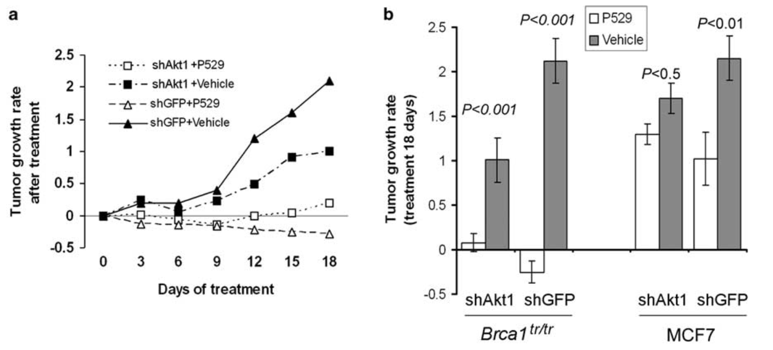
RES-529 Suppressed the Tumor Growth of Several Breast Cancer Orthotopic Xenografts
RES-529 was tested in orthotopic xenografts of both Brca1^{tr/tr} MEFs or MCF7 cells expressing GFP or Akt1 shRNA. Nine weeks after tumor implantation mice were treated with RES-529 at 40mg/kg or vehicle for 18 days. Suppression of tumor growth was observed in all experiments.
*Data from Xiang T. et al. Oncogene 20011May26;30(21):2443-50.
RES-529 = P529 = Palomid 529

Slide 32
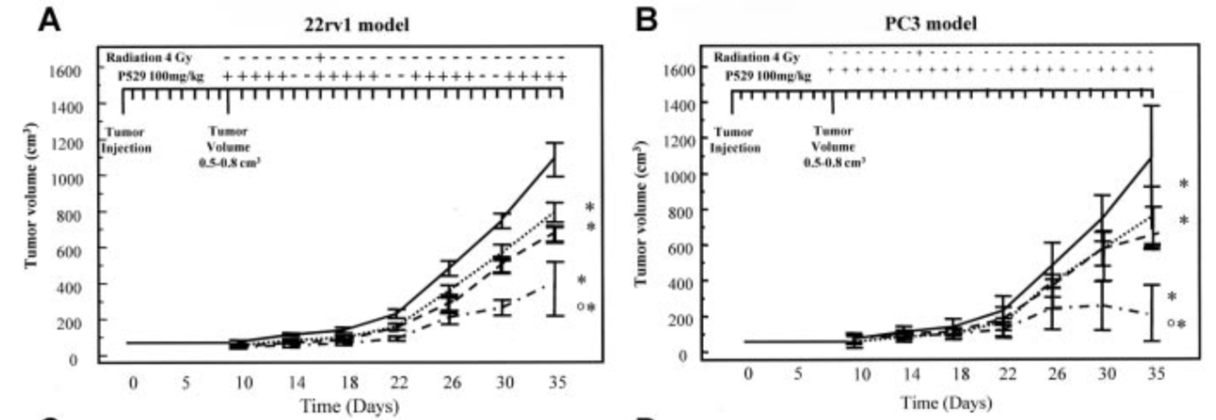
RES-529 Enhanced the Effect of Radiation Therapy in Prostate Cancer Xenografts
RES-529 was evaluated in PC-3 and 22rv1 xenografts alone and in combination with either radiation therapy (XRT). Tumors were injected subcutaneously and grew to 0.5-0.8cm³ (~10 days) and treatment was initiated.
RES-529 (100mg/kg po 5d/wk), XRT (4Gy single fraction), or RES-529 + XRT were tested.
*Data from Gravinia GL. et al. Prostate 2014JanJun74(8);852-68.
RES-529 = P529 = Palomid 529

Slide 33
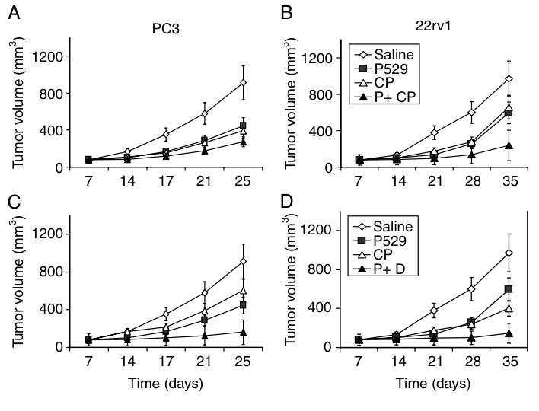
RES-529 Enhanced the Effect of Chemotherapy in Prostate Cancer Xenografts
RES-529 was evaluated in PC-3 and 22rv1 xenografts alone and in combination with chemotherapy (docetaxel [DTX] or cisplatin [Cis]). Tumors were injected subcutaneously and grew to 0.5-0.8cm³ (~10 days) and treatment was initiated.
RES-529 (100mg/kg po 5d/wk) vs. DTX (7.5 mg/kg/wk IP), Cis (30mg/kg q21d), RES-529 + DTX, and RES-529 + Cis were tested
*Data from Gravinia GL. et al. Endocrine Related Cancer (2011);18:385-400
RES-529 = P529 = Palomid 529

Slide 34
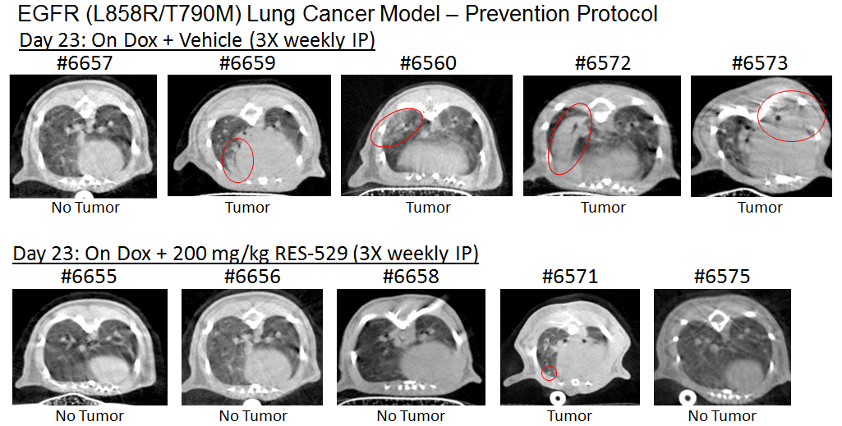
RES-529 Inhibits Growth in Doxycycline Induced EGFR (T790M) Lung Cancer Model
RES-529 was tested in a doxycycline (dox) induced lung cancer model (EGFR [L858R/T790M]). Mice began IP injections of RES-529 concurrent with dox in a prevention modality study.

